Slide 1



The Impact of FDI on the Moldovan Economy
Invest Moldova Agency

Slide 2

FDI Context
| Global and Regional Trends
| FDI dynamics in Moldova
| Structure of FDI by source and sector

Slide 3
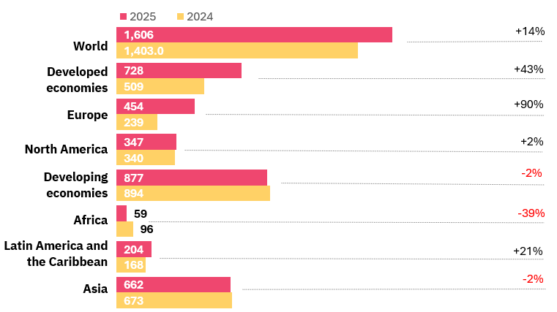
Global FDI recovery remains uneven and fragile
FDI inflows, global and by group of economies
(USD billion and year-on-year percentage change)
Global FDI flows increased in 2025, but growth was largely driven by financial hubs and conduit flows
Core investment indicators remain weak, with declines in M&A, project finance and greenfield activity
Investment flows are increasingly concentrated in advanced economies and capital-intensive sectors
Source: UNCTAD

Slide 4
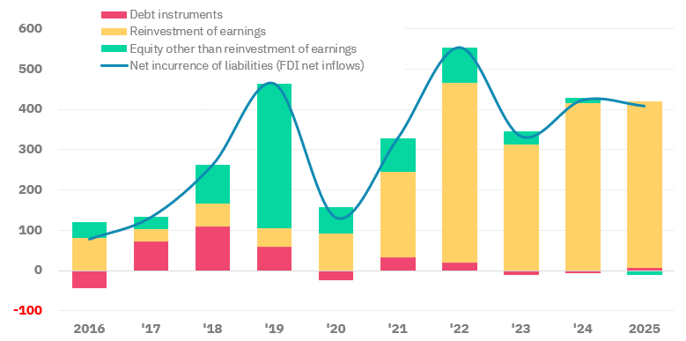
FDI inflows are driven by reinvested earnings
Net FDI inflows by instruments
(EUR million)
Recent FDI inflows are primarily supported by reinvested earnings
Limited new capital inflows shape the pace of expansion
Current dynamics reflect confidence of existing investors rather than new market entry
Source: NBM, International Accounts of the Republic of Moldova

Slide 5
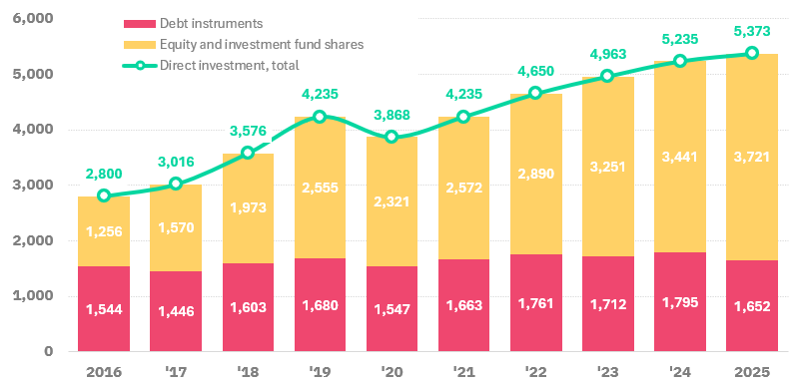
FDI stock continues to grow
FDI Stock, end of year
(EUR million)
FDI stock has increased gradually over the past decade
Growth reflects ongoing reinvestment and capital accumulation
The overall trend indicates a stable and established investment base
Source: NBM, International Accounts of the Republic of Moldova

Slide 6
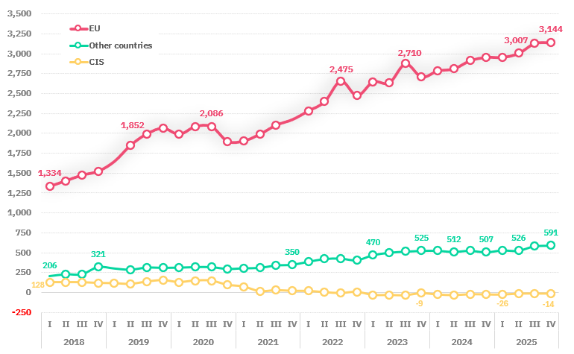
FDI in Moldova is strongly anchored in the European Union
FDI Stock by region
(EUR million)
The European Union is the main source of FDI, with a strong and consistent presence
Other regions contribute more modestly, indicating scope for further diversification
The geographic structure reflects a strong alignment with European investment flows
Source: NBM, International Accounts of the Republic of Moldova

Slide 7
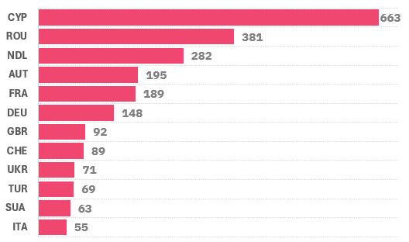
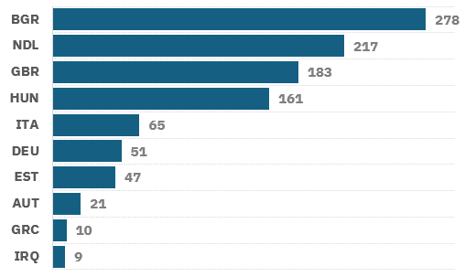
FDI is concentrated among a core group of countries
FDI by country – other sectors
(EUR million)
FDI by country – banking sector
(EUR million)
Source: NBM, International Accounts of the Republic of Moldova
Source: NBM, International Accounts of the Republic of Moldova
The top five countries account for approximately 56% of total equity capital
The investment base combines direct investors and investment platforms and financial hubs
This structure highlights both investment continuity and opportunities for further diversification of sources

Slide 8
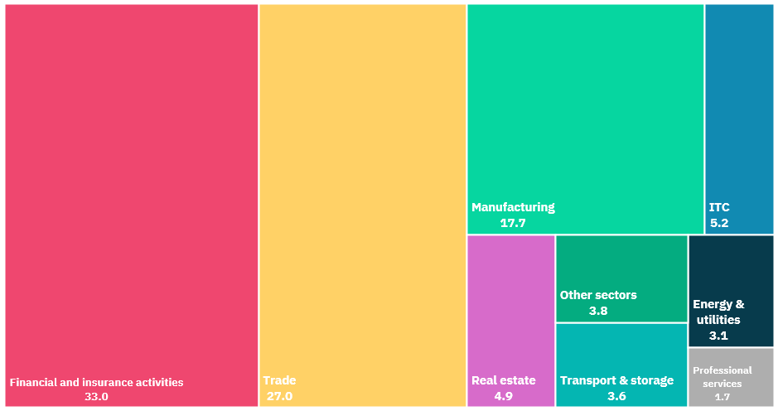
FDI is concentrated in services and trade
FDI by industry, 2025
(percentages)
There is scope to further expand FDI into higher value-added activities
Source: NBM, International Accounts of the Republic of Moldova

Slide 9
The Economic Impact of FDI
| FDI flows (% of GDP)
| FDI stock (% of GDP)
| FDI flows per capita
| FDI stock per capita
| FDI share in gross fixed capital formation

Slide 10
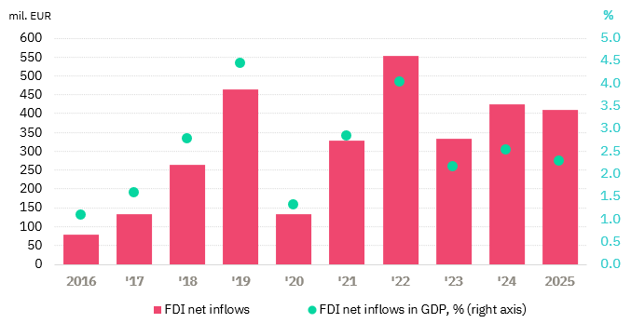
FDI inflows have stabilized at a moderate level
FDI flows (% of GDP), 2016–2025
FDI flows accounted for approximately 2.3% of GDP in 2025, slightly below 2024 but above 2023
Current levels remain below previous peak years
The current level suggests growth potential, particularly through stronger inflows of new investment
Source: NBM, International Accounts of the Republic of Moldova

Slide 11
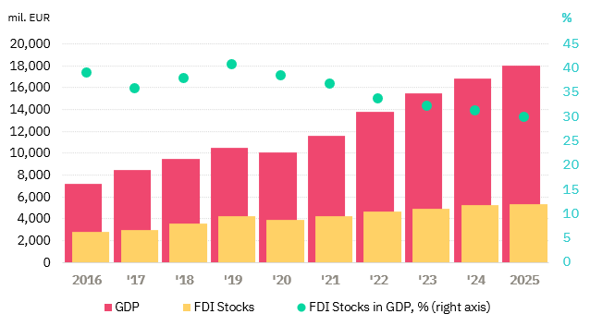
FDI stock growth is outpaced by the economy
FDI stock (% of GDP), 2016–2025
FDI stock accounted for approximately 29.8% of GDP in 2025, down from over 40% in 2019
This reflects a faster growth of the economy compared to the accumulation of FDI
As a result, domestic investment is playing a growing role
Source: NBM, International Accounts of the Republic of Moldova

Slide 12
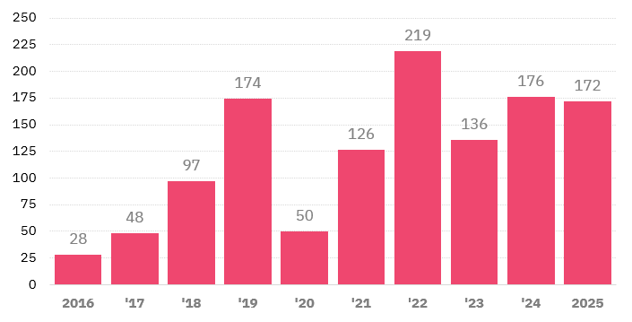
FDI inflows per capita reflect episodic investment patterns
FDI flows per capita, 2016–2025
(EUR)
FDI inflows reached approximately EUR 172 per capita in 2025
The evolution reflects cyclical increases in investment inflows over time
This highlights the importance of generating new investment cycles
Source: NBM, International Accounts of the Republic of Moldova

Slide 13
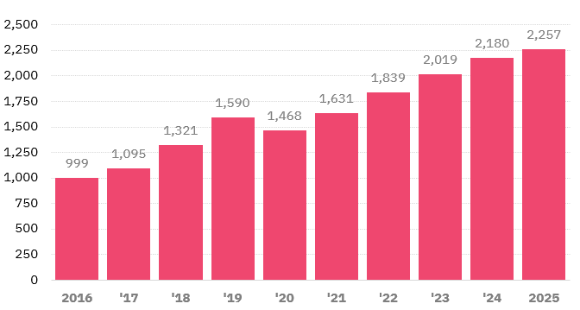
FDI stock per capita reflects sustained capital accumulation
FDI stock per capita, 2016–2025
(EUR)
FDI stock per capita reached approximately EUR 2,257 in 2025, more than double the level recorded in 2016
The increase reflects the continued accumulation of foreign capital over time
The indicator is also influenced by demographic dynamics, particularly population decline
Source: NBM, International Accounts of the Republic of Moldova

Slide 14
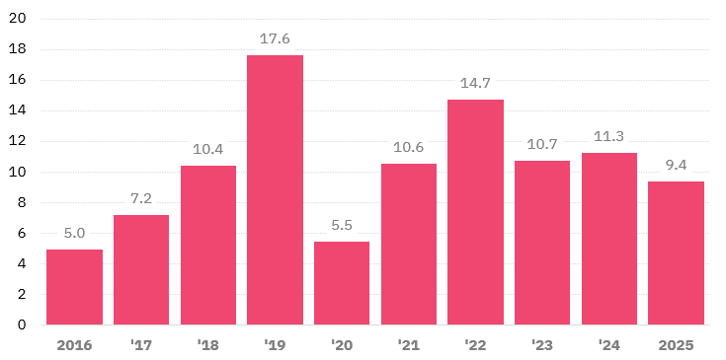
FDI remains a key component within an evolving investment structure
FDI share in gross fixed capital formation, 2016–2025 (%)
(percentages)
FDI represents a more moderate share of total investment
This reflects the increasing role of domestic capital formation
The overall structure points to a more balanced investment model
Source: NBM, International Accounts of the Republic of Moldova

Slide 15
Key takeaways
1
Stable inflows - FDI flows have stabilized at a moderate level (2–2.5% of GDP).
2
Reinvestment - Growth is driven mainly by the reinvestment of profits by existing investors.
3
Accumulation - The stock of FDI reflects steady long-term accumulation, reaching EUR 5.4 billion.
4
Domestic capital - Domestic investment is playing an increasingly important role in the economy.
5
Greenfield potential - Future growth depends on attracting new investment, including greenfield.
18

Slide 16
Strategic priorities – from stabilization to growth
Attracting new capital
Diversifying sources
Prioritizing greenfield projects and large-scale investments, which are currently missing from the investment dynamics.
Reducing dependence on a narrow group of countries — the top 5 account for 56% — and expanding the investor base.
Value-added sectors
Quality, not just volume
Redirecting FDI toward IT&C, energy, and professional services, which remain underdeveloped.
Investments focused on exports and integrated into value chains, generating multiplier effects.
19

Slide 17


Contact us:
+373 22 27 36 54
office@invest.gov.md

