Slide 1
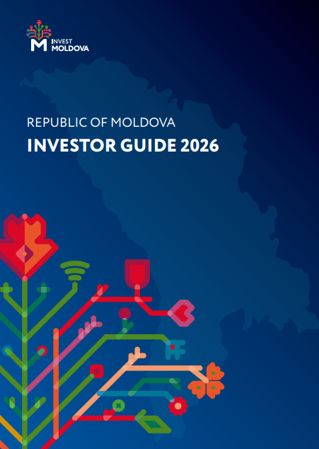

INVEST MOLDOVA AGENCY
Investor Guide
2026
Republic of Moldova
Gateway to Europe
Strategic Location, Competitive Edge, EU Pathway
Economic Diplomatic Club • 2026 • Chișinău, Republic of Moldova
Evelina DESCALUI | Head of Aftercare Department

Slide 2

Why this Guide - and why now
A 20-minute
walk through the
Investor Guide
2026
The Investor Guide 2026, developed by the Invest Moldova Agency, represents an updated and enhanced version of the 2025 edition, reflecting the latest developments in Moldova’s investment landscape and business environment.
The guide brings together, in one comprehensive resource, the key information investors need to make informed decisions: the country’s strategic advantages, macroeconomic outlook, priority sectors, incentive framework, and practical steps for establishing and operating a business in Moldova.
Serving as a practical roadmap for investor engagement, the guide supports companies in understanding opportunities and navigating the investment process.
Today’s presentation provides an overview of the guide’s structure, key chapters, and the information available to support investor discussions.
18
47
2028
chapters,
one reference
countries via
free-trade access
target year for
full EU membership

Slide 3





WHAT'S INSIDE
Eighteen chapters, four questions every investor asks
Why Moldova
Where to invest
How it's taxed
How to operate
Economic overview & ratings
Gateway to growth
EU accession path
Foreign direct investment
V. Investment opportunities
VI. Doing business in Moldova
VII. Intellectual property/data protection
XVI. Ukraine reconstruction
XVII. Real estate
IX. Tax framework (comparative)
X. Special incentives & facilities
XI. Customs regimes
VI. Setting up a business
XII. Labour market
XIII. Residence & work permits
XIV. Education & talent
XV. Infrastructure
XVIII. Financing
1

Slide 4


I
WHAT YOU'LL FIND IN THE GUIDE
Economic Overview of the Republic of Moldova
The macro picture, key indicators and how Moldova is rated by the world's institutions — the starting point for any investment case.
USD 20.1 bn
+2.4%
USD 8,441
3.8%
2.4 mn
72 yrs
GDP (2025 est.)
GDP growth 2025
GDP per capita
Unemployment
Population
Life expectancy
Resilient through shocks
Independently rated & ranked
Despite the war in Ukraine, an energy crisis and severe drought, Moldova has built a solid base for long-term growth. The IMF projects ~1.9% growth in 2026 and ~3.2% in 2027 as the external environment normalises.
The guide compiles Moldova's full scorecard — Moody's B2, S&P B+, Fitch BB (all stable), plus its standings on Economic Freedom, the Global Innovation Index, English Proficiency, Corruption Perceptions and Soft Power.
Investor Guide 2026 • Invest Moldova Agency
2

Slide 5





II
WHAT YOU'LL FIND IN THE GUIDE
A Gateway to Growth & Innovation
Chapter II distils the country's competitive edge into a set of clear advantages an investor can act on.
Strategic location
Advantageous tax
Free-trade reach
1–3 hours by air from major EU hubs; Giurgiulești deep-water port links Moldova to Black Sea maritime trade.
12% income tax, deferral on reinvested profit, 20% VAT (8% reduced), and a 7% flat tax inside MITP.
DCFTA with the EU, CEFTA, GUAM, EFTA, Turkey & UK — preferential access to 870+ million consumers.
Digital & efficient
Competitive workforce
Reform leader
77%+ of business services online, fast remote company registration, unified e-permits platform.
Young, multilingual talent (RO, RU, EN, FR, IT, ES, DE) at competitive wages, strong in IT & manufacturing.
Highest reform-implementation rate among EU candidates (93%); EUR 1.9 bn EU Growth Plan 2025–2027.
Investor Guide 2026 • Invest Moldova Agency
3

Slide 6
THE EU ACCESSION JOURNEY
III
WHAT YOU'LL FIND IN THE GUIDE
The EU Accession Pathway
EU Growth Plan 2025–2027: €1.9B support package | 93% reform implementation rate — highest among all EU candidate states | DCFTA guarantees preferential EU market access. First two tranches already disbursed (Jul 2025, Mar 2026).
Mar 2022
Dec 2023
Oct 2024
2025–27
Target 2028
EU Application
submitted
Accession
negotiations opened
Negotiating framework
adopted
Reform & Growth Facility - up to €1.9 bn
Target for full EU membership
4
Notes:
Moldova's EU path is not a distant dream — it is a structured, funded, and actively progressing process. Since applying in March 2022, Moldova opened accession negotiations by December 2023, the fastest in EU enlargement history. The €1.9 billion EU Growth Plan, activated in 2025, directly supports Moldova's socioeconomic reforms. Full membership is targeted for 2028. For investors, this means progressively harmonized regulations, access to EU single market, and a dramatically more predictable business environment.

Slide 7
IV
WHAT YOU'LL FIND IN THE GUIDE
Foreign Direct Investment
Who already invests here, how much, and in which sectors — the proof points that build investor confidence.
FDI by sector
USD 6.32 bn
Total FDI stock (31 Dec 2025)
84.5%
20.1%
from the EU
of gross value added
60+ source countries · 10,000+ foreign-owned companies
Net FDI inflow held positive at USD 459.5 m in 2025. Equity & shares make up 69.2% of the stock.
Investor Guide 2026 • Invest Moldova Agency
5

Slide 8






IV
WHAT YOU'LL FIND IN THE GUIDE
Proof of Concept: Success Stories
The guide profiles flagship investors already thriving in Moldova — across automotive, construction, energy, tech and mobility.
DRÄXLMAIER
Gebauer & Griller
Knauf
Germany · Automotive
Austria · Cabling
Germany · Construction
~5,000 staff across Bălți, Chișinău & Cahul; pioneer of dual education in Moldova since 2007.
Two factories in Bălți, ~1,200 employees; e-mobility & autonomous-driving harnesses.
Largest branded building-materials maker on the market; new Bălți plasterboard plant (2024).
ROCA Industry
Premier Energy
Bolt
Romania · Materials
Distribution & solar
Estonia · Mobility
CEE's largest fibreglass-mesh producer at Vulcănești; ~€2.57 m capacity expansion in 2026.
~€381 m invested since 2000; 15 PV parks, 35.57 MW installed, listed in Bucharest.
180,000+ users, 6 m+ km travelled; first fully digital ride-hailing platform in Moldova.
Investor Guide 2026 • Invest Moldova Agency
6

Slide 9






V
WHAT YOU'LL FIND IN THE GUIDE
Investment Opportunities & State Aid
Chapter V sets out where the government actively wants — and co-finances — new investment.
Priority manufacturing sectors
Regional State Aid Scheme (GD 875/2024)
Automotive parts
Electronics
MDL 2 bn
60%
total envelope (~€100 m)
max aid intensity
Chemical & pharma
Textiles & footwear
Combined support:
25% non-reimbursable grant + 75% partial corporate-tax exemption, for projects of MDL 10 m+. In 2025, 20 agreements were signed totalling ~MDL 2.0 bn of investment.
Agrifood
Construction materials
Investor Guide 2026 • Invest Moldova Agency
7

Slide 10






VI–VII
WHAT YOU'LL FIND IN THE GUIDE
Setting Up & Protecting Your Business
How quickly and securely a company can be established — and how its ideas and data are protected.
Fast, contactless set-up
No physical presence needed
Trusted digital tools
Companies are incorporated on registration with the Public Services Agency — a swift, streamlined process.
Foreign investors can establish a company remotely; personal ID numbers are issued without Moldovan documents.
eKYC, eNotary and MobiSign secure identification, authentication and signing — ideal for diaspora & foreign founders.
IP aligned to EU standards
Data protection
National treatment
A full body of laws on trademarks, inventions, designs, copyright, trade secrets & geographical indications.
Personal-data framework harmonised with European standards — reassurance for data-driven businesses.
Foreign investors receive the same legal protection as domestic ones across IP and investment law.
Investor Guide 2026 • Invest Moldova Agency
9

Slide 11

VII+
WHAT YOU'LL FIND IN THE GUIDE
Priority Sectors at a Glance
Three engines of the economy — each with its own chapter, data and incentive logic in the guide.
ICT
Renewable energy
Agriculture
Best-performing sector
Green transformation
A traditional pillar
USD 840 m
1,023 MW
~7.4%
IT exports 2025
installed capacity
of GDP
~7.5%
~29.1%
71
of GDP
of consumption
wine export markets
Top-50 globally for internet speed; ~80% of output exported. MITP residents pay a 7% flat tax.
Near the 30% / 2030 target. Competitive tenders (105 MW wind + 60 MW PV) drew €190 m+; 15-yr PPAs.
Fertile chernozem on ~75% of land; world top-10 in walnuts. Seven product groups liberalised to the EU.
Investor Guide 2026 • Invest Moldova Agency
8

Slide 12




VIII
WHAT YOU'LL FIND IN THE GUIDE
Investment Guarantees
The legal certainty an investor needs — and the modernised framework coming next.
Equal protection for local and foreign investors
Moldova is a WTO member; Law 81/2004 underpins today's guarantees, and a new investment law will modernise the regime to European standards — strengthening the country's competitiveness.
What the new framework will deliver
Legal stability & certainty for investors
One-stop-shop regime for strategic investments
Stronger protection, incl. investor–state disputes
Capital steered to strategic sectors & regions
Digitalised interaction with public authorities
Clear, transparent government investment agreements
Investor Guide 2026 • Invest Moldova Agency
10

Slide 13


IX
WHAT YOU'LL FIND IN THE GUIDE
Tax Framework — Comparative Analysis
A transparent, competitive system — the headline rates every CFO will check first.
12%
20%
6%
12%
Corporate income tax
VAT (8% reduced)
Dividends (non-resident)
Interest & royalties
Reinvested profit deferral
Special-area regimes
SMEs that reinvest 2023–2026 profits (rather than pay dividends) defer income tax until dividends are actually distributed — capital stays in the business.
Layered on top: dedicated incentives for residents of IT parks, free economic zones and industrial parks (next slide) — among the most generous in the region.
Investor Guide 2026 • Invest Moldova Agency
11

Slide 14


X
WHAT YOU'LL FIND IN THE GUIDE
Special Incentives: MITP, Free Zones & Parks
Three special regimes that can transform a project's economics — each detailed in Chapter X.
Moldova Innovation Technology Park
Free Economic Zones
Customs & VAT relief and reduced income tax for export-oriented production and logistics within designated zones.
7%
USD 1 bn+
flat tax on turnover
resident turnover 2025
~26,000 specialists · ~89% of sales exported · 10× turnover growth since 2018
Industrial Parks
Ready-to-use serviced land and infrastructure with fiscal facilities — fast-track siting for manufacturers.
A single 7% tax replaces income tax, social & health contributions, local taxes and more.
Investor Guide 2026 • Invest Moldova Agency
12

Slide 15



XI
WHAT YOU'LL FIND IN THE GUIDE
Customs Regulations
Special customs regimes let goods move and be processed efficiently — key for export-driven models.
Inward processing
Outward processing
Customs warehousing
Import goods duty-suspended for processing, then re-export — ideal for contract manufacturing.
Send goods out for processing and re-import with relief on the value added abroad.
Store imported goods without paying duties until they enter the market.
Transit
Temporary admission
Trade-agreement origin
Move goods across the territory under customs supervision with suspended duties.
Bring in equipment temporarily with partial or full relief from import duties.
Preferential origin rules under DCFTA, CEFTA & other FTAs reduce or remove tariffs.
Investor Guide 2026 • Invest Moldova Agency
13

Slide 16



XII–XIV
WHAT YOU'LL FIND IN THE GUIDE
People: Labour, Permits & Talent
Everything an employer needs to know about hiring, mobility and the skills pipeline.
Labour market
Residence & permits
Education & talent
MDL 6,300
≤ 1 yr
62,900
min. wage 2026 (~€310)
work permit (renewable)
higher-ed students (+6.8%)
MDL 17,400
Art. 361
≤ 50%
forecast avg. wage (~€862)
investor residence route
state funding for dual education
Overtime pay, remote work with equal rights, and clear rules for hiring foreign nationals.
Investors who are partners/shareholders — or who create jobs — can obtain temporary residence.
Romanian-language teaching with EN/RU/FR programmes; growing dual-education partnerships.
Investor Guide 2026 • Invest Moldova Agency
14

Slide 17



XV
WHAT YOU'LL FIND IN THE GUIDE
Infrastructure & Connectivity
The physical and digital backbone — roads, rail, air, energy and telecoms — that moves goods and data.
9,500 km
1,150 km
6.08 mn
20.2 mn t
public roads
railway network
airport passengers 2025
freight carried 2025
Transport
Energy
Telecom & digital
9,500+ km of roads and a 1,150 km rail network ready for modernisation; Eugen Doga Airport hit 106.8% of its 2025 target (+46.8% YoY).
Ongoing grid modernisation to absorb renewables and ensure reliable distribution, backed by international funding.
Top-tier fixed-internet speeds at globally competitive prices — a strong base for digital and BPO operations.
Investor Guide 2026 • Invest Moldova Agency
15

Slide 18

XVI –XVII
WHAT YOU'LL FIND IN THE GUIDE
Reconstruction of Ukraine & Real Estate
Two forward-looking opportunity sets — a regional growth catalyst and a maturing property market.
Moldova & the reconstruction of Ukraine
Real estate market
USD 588 bn
USD 590 m+
€1,720/m²
11.2%
est. recovery cost (10 yrs)
MD–UA opportunities
Chișinău residential 2025
yield, Class-A offices
The largest investment project in post-war Europe. Concrete openings across Odesa, Vinnytsia & Chernivtsi in logistics, energy, manufacturing, agri-food and dual-use tech. A 2026 KSE–IMA study maps the opportunity.
Prices rose from €1,030/m² (2022) to €1,720/m² (2025). Office yields 8.3–11.2%; modern warehousing ~7.3%. Foreigners may own private land — with limits on agricultural & forestry land.
Investor Guide 2026 • Invest Moldova Agency
16

Slide 19


XVIII
WHAT YOU'LL FIND IN THE GUIDE
Financing a Business in Moldova
The funding ecosystem — where to find capital, grants and guarantees once a project is decided.
Bank financing
State aid
ODA programmes
AIPA (agriculture)
Short- & long-term loans, credit lines and leasing from a diversified banking sector (collateral & business plan required).
Grants, fiscal incentives, investment funds and the regional aid scheme for manufacturing.
Start-up & growth grants (up to MDL 5 m), FACEM investment loans, Program 373 subsidies and guarantees up to 80%.
Direct payments, sectoral interventions and rural-development support for the agri-food sector.
Investor Guide 2026 • Invest Moldova Agency
17

Slide 20

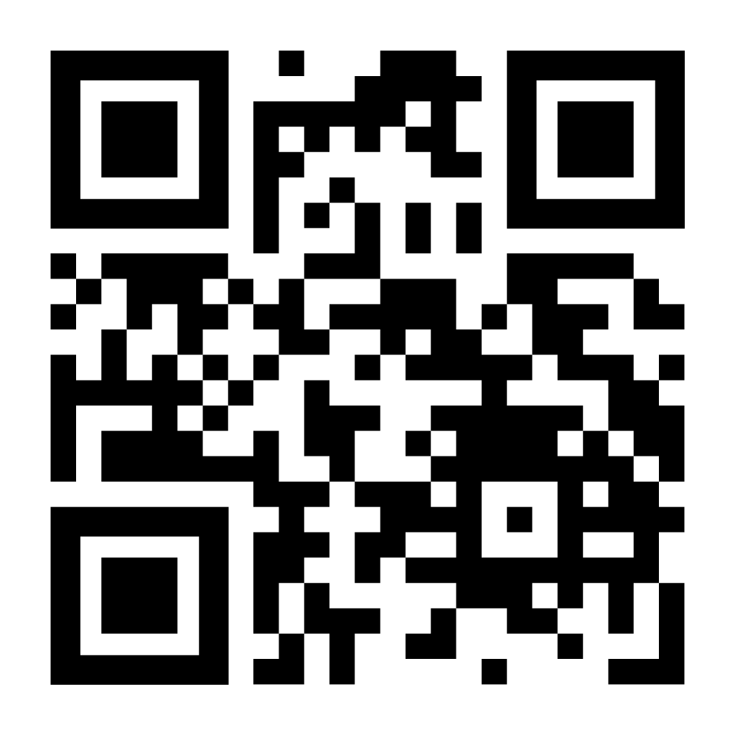
MOLDOVA IS OPEN FOR BUSINESS
Invest Moldova Agency - your partner for strategic investments in the Republic of Moldova
🌐 Website:
https://invest.gov.md/en/home-2/
📧 Email:
office@invest.gov.md
📞 Phone:
+373 22 27 36 54
Scan to visit
the website page
📍 Address:
2, Eugen Doga Street, Chișinău, Moldova, MD-2005
"Your investment journey begins with one call.
We handle everything else."

