Slide 1
SUPPORT2SME4SD Third training
17 January 2024
Online

Slide 2
Agenda
European Semester 2024 and Autumn Package
Pay Transparency Directive
Commission Recommendation for Effective Active Support to Employment

Slide 3
The European Semester 2024 and the Autumn Package
The European Union’s framework for the coordination and surveillance of economic and social policies. Now together with the Recovery and Resilience Facility;
Policy coordination starts in November when the Commission sets the priorities for the year to come.
The cycle ends in October of the following year, when national governments submit draft budgetary plans taking into account the EU recommendations adopted by the Council in summer.

Slide 4
Objectives and priorities

Slide 5
Timeline

Slide 6
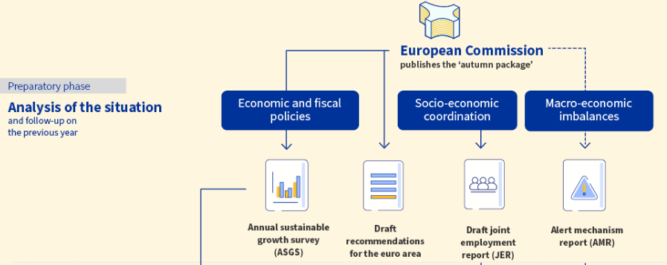

Slide 8
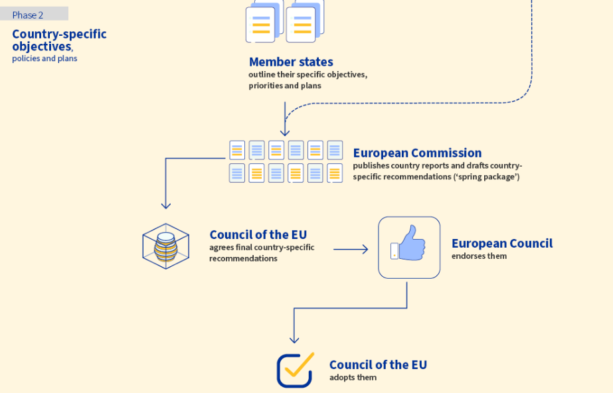

Slide 9
The Autumn Package
Kicks off the annual European Semester cycle. The Commission sets out general social and economic priorities for the EU and provides EU countries with policy guidance. It was published on the 21/11/2023
It is composed of:
The Annual Sustainable Growth Survey: agenda for coordinated EU policy responses, to enhance competitiveness through the green and digital transition (in line with social fairness and territorial cohesion objectives).

Slide 10
The Autumn Package
Opinion on Draft budgetary Plans of euro area Member states: ensures the respect of EU’s economic governance rules
Recommendation for the euro area: tailored advices to Members states on fiscal, financial and structural issues
Alert Mechanism Report: aims to detect, prevent and correct imbalances
Joint Employment Report: analyses employment and social situation in Europe and the policy responses of national governments. Includes a country summary

Slide 11
Employer’s views on the 2024 ASGS
European Social Partners were asked to provide their views and priorities ahead of the publication of the ASGS. SMEunited coordinated with the other employers:
Labour and skill shortages remain one of the main concerns
Tailor-made solutions to fight inactivity
Further engagment of social partners in collective bargaining of wages
Development of skills and compétences for the green transition
Foster the interplay between skills and migration

Slide 12
Role of social national partners
At EU level:
SME organisations and national social partners have a key role to play to influence the National Reform Programmes, the Country Reports and the Country-Specific Recommendation:
contact and meet the European Semester Officer in your country
be involved in the annual fact finding missions
Ask for a clear overview of the deadlines for providing input/feedback

Slide 13
Role of social national partners
At national level:
contact the relevant ministries in your country and ask for a clear overview of the deadlines for the involvement in the drafting of the National Reform Programmes.
request to be involved in the drafting of the National Reform Programmes based on the process of consultation that is in place in your country.
when analysing the draft National Reform Programme, ensure that the main reforms you would like your government to tackle are included.

Slide 14
Questions for discussion
1) Have you been consulted/contacted by your European Semester Officer? If yes, with other social partners?
2) What is the level of involvement of social partners in the national reforms in your country (drafting & monitoring implementation)?
3) Do you have a clear overview of the consultation process/timeline in your country?

Slide 15
Pay Transparency Directive
On 4 March 2021 the Commission published its proposal for a directive. The European Parliament and the Council, led by the Czech presidency, reached a political agreement on 15 December 2022.
The European Parliament adopted the directive at its plenary on 30 March 2023.
The right to equal pay between women and men for equal work or work of equal value is enshrined in Article 157 TFEU and in Directive 2006/54/EC on equal pay -> improve implementation of these principles.

Slide 16
The core concept: equal pay for equal work or work of equal value 1 / 2
The value of work should be assessed and compared on the basis of objective criteria, including educational, professional and training requirements, skills, effort, responsibility and working conditions, irrespective of differences in working patterns -> To reach and ensure gender-neutral job evaluation.
To facilitate the application of work of equal value, 4 key criteria can be used: skills (including soft skills) required, efforts provided, responsibilities and working conditions -> identified as essential and sufficient by the EU, regardless of the economic sectors.

Slide 17
The core concept: equal pay for equal work or work of equal value 2/2
The purpose of a gender-neutral pay structure is to understand if workers are in a comparable position, in order to assess if they are paid equally.
It belongs to Member States, in consultation with equality bodies, to ensure that the relevant methodologies and analytical tools are made available and easily accessible to employers and/or social partners, in order to implement gender-neutral job evaluation.
When assessing whether female and male workers are in a comparable situation, the key criteria is not the employer but the single source establishing the pay conditions.

Slide 18
Obligations of employers and right of information 1/2
Employers shall make accessible to their workers the criteria that are used to determine workers’ pay, pay levels and pay progression. Member States may exempt employers with fewer than 50 workers.
Workers have the right to request and receive in writing, information on their individual pay level and the average pay levels, broken down by sex, for categories of workers performing the same work as them or work of equal value to theirs (they can do so through workers’ representatives or through an equality body). Employers have to reply within two months.

Slide 19
Obligations of employers and right of information 2/2
Employers shall inform all workers, on an annual basis, of their right to receive the criteria that are used to establish pay.
It also covers applicants, which should receive the initial pay and its range.
Workers shall not be prevented from disclosing their pay for the purpose of the enforcement of the principle of equal pay. Employers can not restrict workers from disclosing information about their pay.
Employers can prohibit workers from disclosing information about pay levels that are not applied to them (unless this information is used to exercise their right to equal pay internally). Workers cannot share pay levels that are not applied to them under any circumstance.

Slide 20
Reporting on pay gap, the staircase system applicable to SMEs
150 to 249 employees: first deadline on 7 June 2027, and every three years thereafter.
100 to 149 employees: first deadline on 7 June 2031 and every three years thereafter.
The directive does not include a reporting obligation for companies with less than 100 employees, and Member States can impose an obligation themselves.
Workers’ representatives shall have access to the methodologies applied by the employer (but they cannot obstruct it nor request any changes).

Slide 21
Reporting on pay gap, what is included? 1/2
the gender pay gap;
the gender pay gap in complementary or variable components (e.g., variable bonuses, additional benefits, etc.);
the median gender pay gap;
the median gender pay gap in complementary or variable components;
the proportion of female and male workers receiving complementary or variable components;
the proportion of female and male workers in each quartile pay band (a “quartile pay band” means each of four equal groups of workers into which they are divided according to their pay levels, from the lowest to the highest)
the gender pay gap between workers by categories of workers broken down by ordinary basic wage or salary and complementary or variable components.
‘gender pay gap’ means the difference in average pay levels between female and male workers of an employer expressed as a percentage of the average pay level of male workers;

Slide 22
Reporting on pay gap, what is included? 2/2
Results have to be shared with the monitoring body, which will publish the report.
The information regarding the gender pay gap between workers by categories of workers broken down by ordinary basic wage or salary and complementary or variable components will be kept confidential.
In case of gender pay difference, employers will be asked to find solutions with workers’ representatives, the labour inspectorate and/or the equality.

Slide 23
Scope of the reporting
All workers, with all kind of contract, as far as there is an employment relationship (including apprenticeships and traineeships) by law.
It concerns all kind of pay: wages, salaries or any other consideration, whether in cash or in kind, which workers receive directly or indirectly, in respect of their employment from their employer.
It also covers bonuses, overtime compensation, travel facilities, housing and food allowances, compensation for attending training, payments in the case of dismissal, statutory sick pay, statutory required compensation and occupational pensions.
It is measured as annual gross pay and the corresponding gross hourly pay.

Slide 24
Joint pay assessment 1/3
Self-remediation tool for companies, out of court mechanism (in cooperation with workers’ representatives), applicable if:
difference in the average pay level between female and male workers of at least 5% in any category of workers;
Such difference is not justified by objective criteria
It has not been corrected within 6 months after the reporting

Slide 25
Joint pay assessment 2/3
It includes:
an analysis of the proportion of female and male workers in each category of workers;
information on average female and male workers’ pay levels complementary or variable components for each category of workers;
any differences in average pay levels between female and male workers in each category of workers;
the reasons for such differences in average pay levels, on the basis of objective, if any, as established jointly by the workers’ representatives and the employer;
the proportion of female and male workers who benefited from any improvement in pay following their return from maternity or paternity leave, parental leave or carers’ leave,
measures to address differences in pay if they are not justified on the basis of objective, gender-neutral criteria;
an evaluation of the effectiveness of measures from previous joint pay assessments (when applicable)

Slide 26
Joint pay assessment 3/3
Needs to identify corrective actions and plan their implementation of the proposed measures within a reasonable timeframe in close cooperationwith the workers’ representatives. Upon their request, the labour inspectorate or equality body can participate in the process.
Accessible to workers and workers’ representatives, and should be communicated to the monitoring body. The labour inspectorate and the equality body should also be able to access the joint pay assessment upon request.

Slide 27
Specificities
Shift of the burden of proof: Unless the employer proves that the infringement to equal pay was manifestly unintentional and of a minor character, it is on the employers to prove that there has been discrimination in relation to pay once an employee considers him/herself wronged before a competent authority.
Limitation period: Members States cannot implement a limitation periods for bringing equal pay claims shorter than 3 years. However, the date at which the limitation period starts to run is fixed by national law.

Slide 28
Questions for discussion
1) How have been using social dialogue to implement equal pay in your country?
2) Have you been involved in the design of gender-neutral job evaluation with the other social partners in your country?
3) Do you already have information concerning the willingness of your government to apply reporting obligations for companies with less than 100 employees?

Slide 29
Commission Recommendation for Effective Active Support to Employment
Stems from the European Pillar of Social Rights -> strategy to transition gradually from emergency measures to new measure for a job-rich economy
Promotion of job creation and job-to-job transitions, including towards the digital and green transition
Provides guidances to develop policy packages around:
(1) hiring incentives and entrepreneurial support
(2) upskilling and reskilling opportunities,
(3) enhanced support by employment services, with a special focus on young people and workers in the sectors worst affected by the pandemic.

Slide 30
Implementation of measures
-> Based on a mapping of skills needs across economic sectors and regions, and should be complemented by the implementation of the relevant country-specific recommendations adopted by the Council in the European Semester.
Social partners should be closely involved in the design and implementation of these policies.
Member States should rely on social dialogue and involve social partners in the design, implementation and evaluation of the policies

Slide 31
(1) Hiring incentives and entrepreneurial support
Hiring and transition incentives to promote quality job creation and support the employability of workers
Accompanying labour market transitions from declining to expanding sectors, including green and digital sectors
Introduce or strengthen support schemes for apprenticeships and paid traineeships, in particular in micro, small and medium-sized enterprises and in sectors facing particular skill shortages.
Support start-up grants, loans and equity to promote entrepreneurship, accompanied by improved access to social protection for the self-employed.

Slide 32
(2) Upskilling and reskilling opportunities
Put in place comprehensive skills strategies for the different economic sectors and ecosystems, supporting for this purpose the cooperation among companies, social partners, education and training institutions
Inform education and training services with up-to-date labour market and skills intelligence
Reinforce the capacities for the recognition and validation of learning and experience gained outside formal education and training to ensure that workers can communicate their skills to prospective employers

Slide 33
(3) Enhanced support by employment services
With a special focus on young people and workers of all ages in the sectors worst affected by the pandemic.
Provide individualised support to jobseekers:
With comprising counselling, guidance and mentoring, assessment and validation of skills, job-search assistance, entrepreneurship support.
Support to workers affected by company restructurings, in close cooperation with companies in search of additional skills and workforce
With facilitating cross-border mobility and promoting the recognition or validation of skills

Slide 34
Questions for discussion
1) Have you been consulted on the design on EASE measures in your country?
2) Did you benefit from EASE measures? Did you witness improvement on the different areas targeted by the EASE?
3) Are you able to monitor and evaluate the policies developped by your governement?

