Slide 1
T-FACTOR HAS RECEIVED FUNDING UNDER HORIZON 2020
RESEARCH & INNOVATION PROGRAMME WITH GRANT AGREEMENT NO. 868887
T-Factor Kaunas Pilot
KAUNAS ALEKSOTAS
15 June 2021

Slide 2
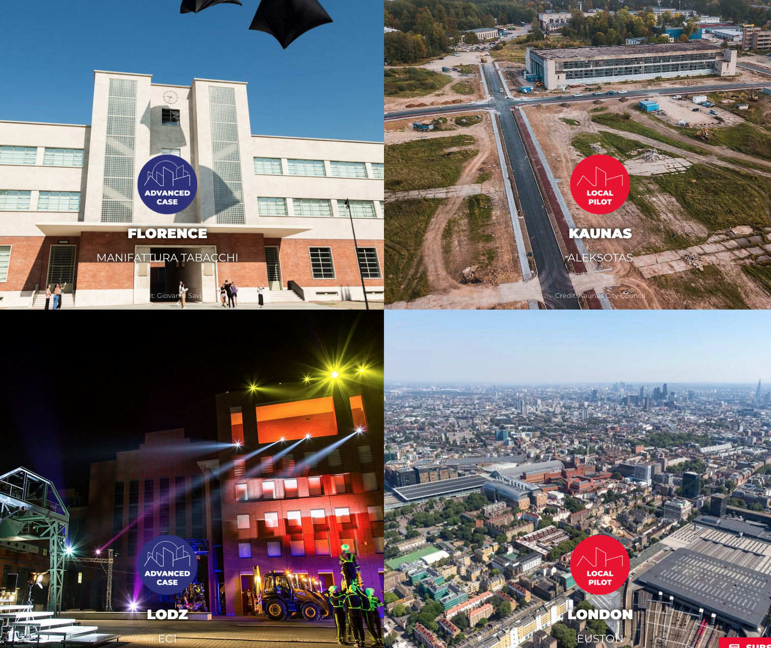
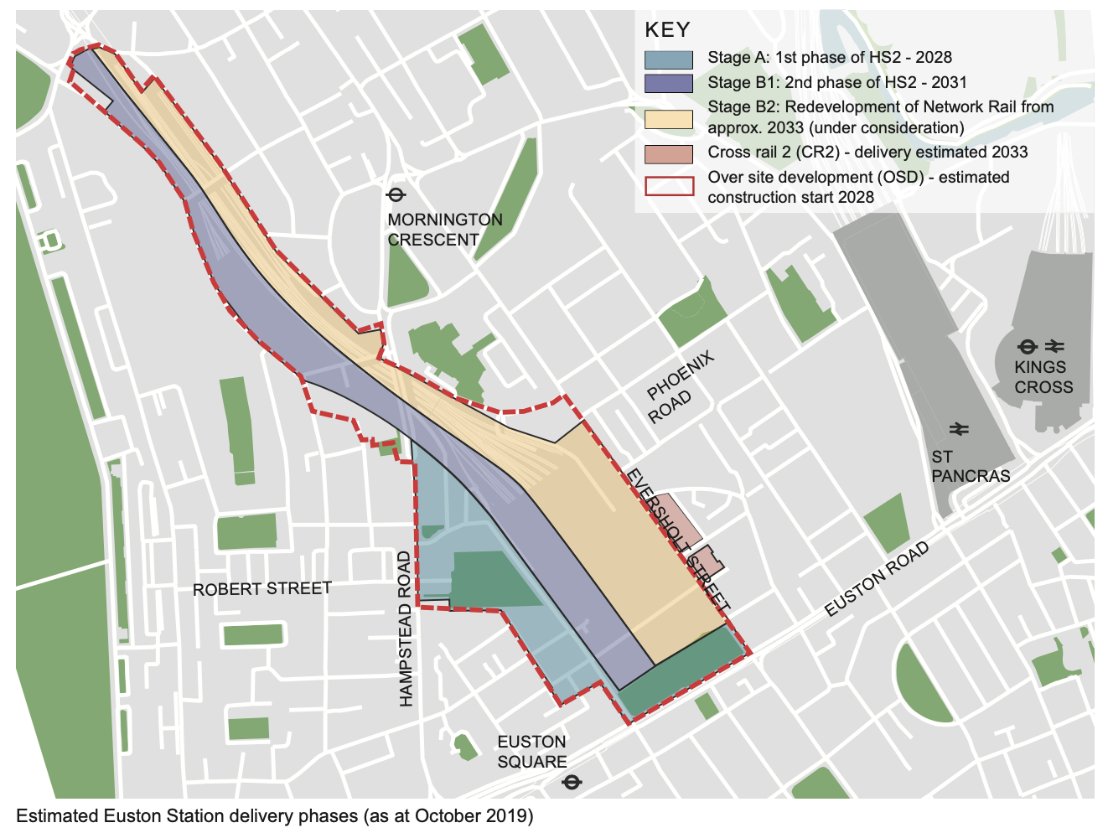
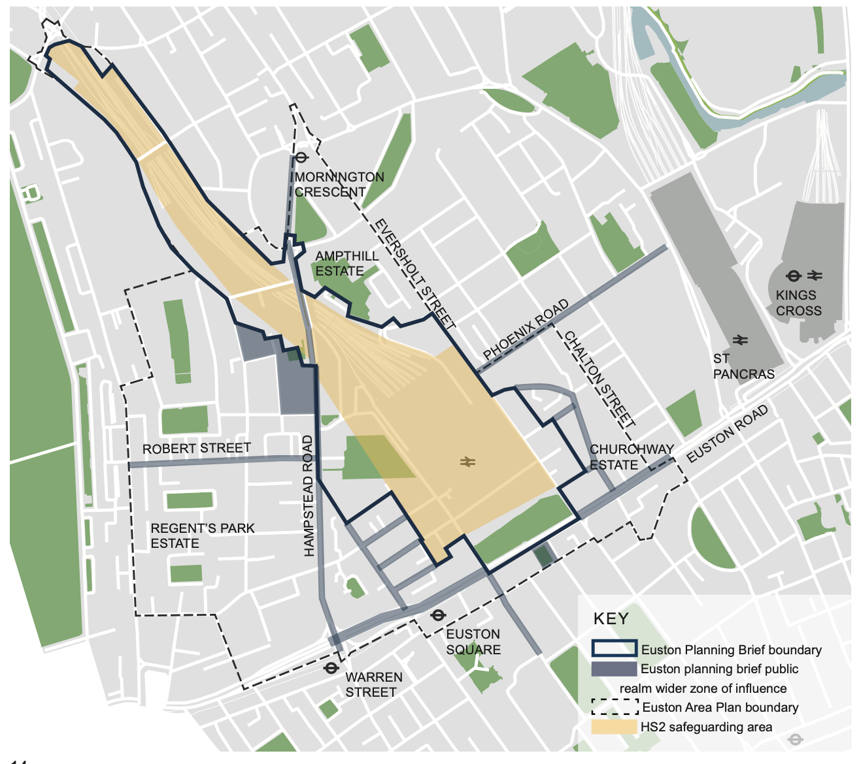
| T-Factor: the project
R
UNLEASHING FUTURE-FACING URBAN HUBS THROUGH CULTURE AND CREATIVITY-LED STRATEGIES OF TRANSFORMATIVE TIME
25 partners (Lead: LAMA Development and Cooperation Agency, Florence)
Two types of partners: 1) pilot cities 2) 'advanced' cases.
Kaunas partners: KTU, Kaunas city municipality, Kaunas 2022
Duration: 48 months (starts from June 2020)
Total budget: 7.9M EUR
Call: H2020-SC5-2018-2019-2020 (Greening the economy in line with the Sustainable Development Goals (SDGs)) Topic: SC5-20-2019 Type of action: IA

Slide 3
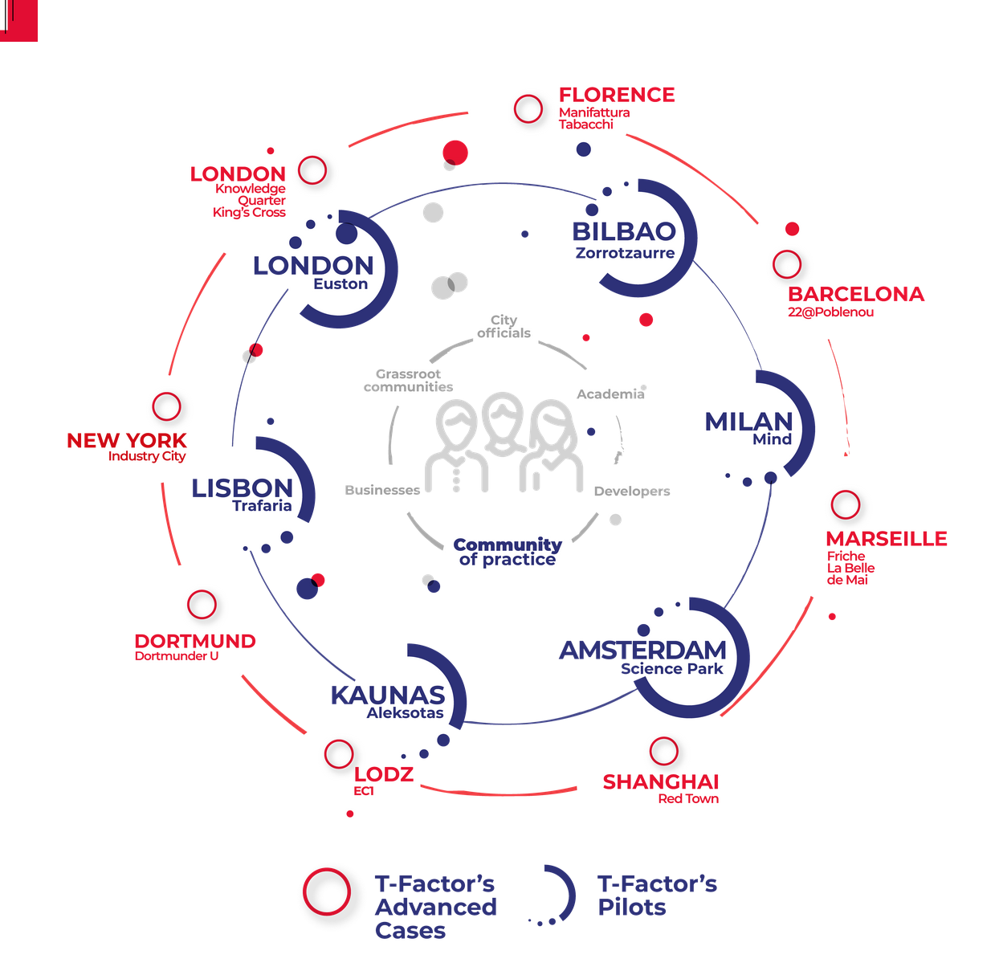
| T-Factor: the project
A
Goal
T-Factor’s goal is to turn a variety of historic urban areas across Europe into vibrant hubs for inclusive urban (re)generation, social innovation and enterprise.
Target
The project targets early stage regenerations in a diversity of historic urban areas in 6 EU cities: London , Bilbao , Amsterdam, Kaunas, Milan & Lisbon, and provides their PPPs with a unique ecosystem of capacity-building for city-making.
CITY MAKING METHOD + CITY MENTORING MODEL

Slide 5
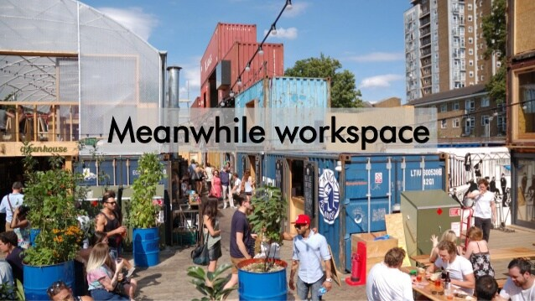
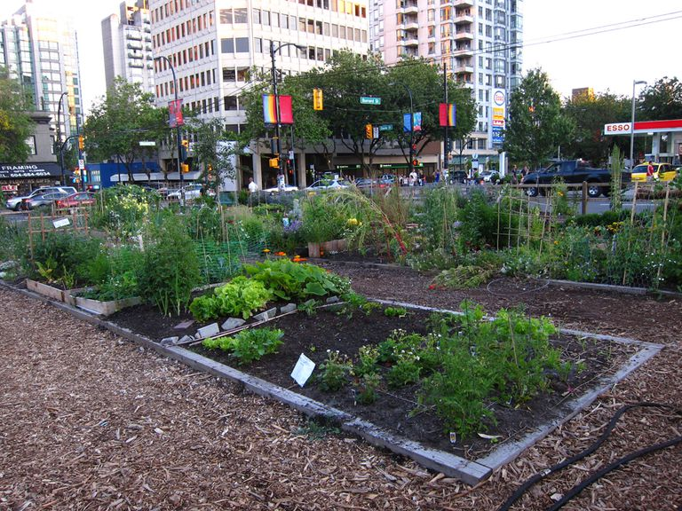
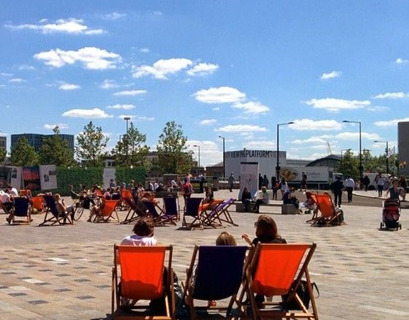
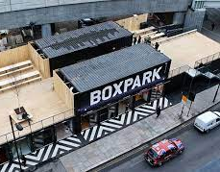
| T-Factor: the project
A
CITY MAKING METHOD > ‘TEMPORARY URBANISM’ > MEANWHILE USES
Prompt uses (events)
Regular uses (training, incubation)
Permanent uses (longer use)

Slide 6
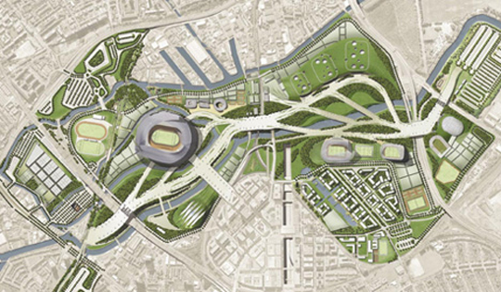
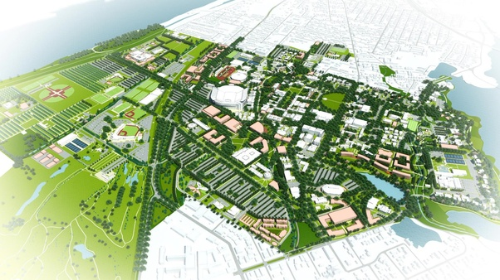
| T-Factor: the project
The challenge
The project challenges the waiting time in urban regeneration (the time in-between the adoption of the masterplan and its actual realization) to demonstrate how culture, creative collaboration and wide engagement can unleash inclusive urban (re)generation, social innovation and enterprise.
The project aims to reshape the waiting time into a transformative time - collective action of city-making.
A masterplan is a dynamic long-term planning document that provides a conceptual layout to guide future growth and development. Master planning is about making the connection between buildings, social settings, and their surrounding environments.
MAKING CITIES IN THE AGE OF UNCERTAINTY

Slide 7
| T-Factor: the project
+
Masterplan
already in place:
delivered by the city through PPP’s
T-Factor Pilot
(soft) activities
aimed to empower the delivery of the masterplan through meanwhile uses and city making (place making)

Slide 8
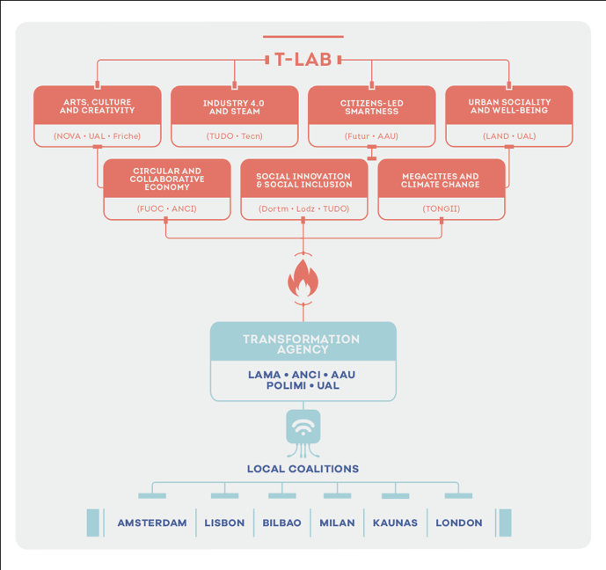
| T-Factor: the project
How it works
Pilots are implemented by:
Local trans-disciplinary team
Local coalition (LC’s) made up of actors from academia, government, industry, citizens and community groups
Supported by:
Transformation Agency mentors the pilots in applying the city- making method;
Transformation Labs (T-Labs) provide thematic expertise over the specific innovation missions in each pilot node

Slide 9
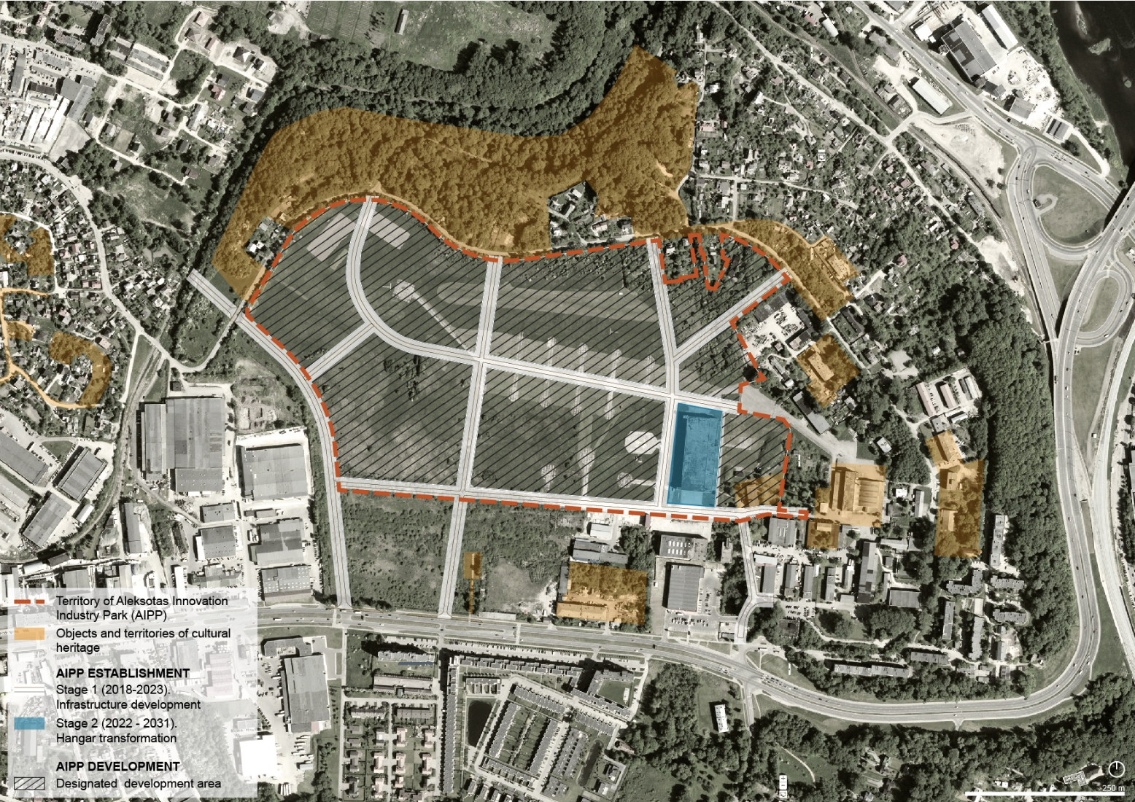
| KAUNAS ALEKSOTAS: Pilot area - AIIP
A
REGENERATION
The Kaunas city aim is to create an Innovation and Industry Park that can become a landmark in Lithuania for R&D in bio-tech forging a sustainable and green energy powered environment.
The development plan is to be prepared by the end of 2021 / the beginning of 2022.
1st development stage 10 years (2022 - 2031)
2nd development stage 10 years (2032 - 2041)
3rd development stage 5 years (2042 - 2046)

Slide 10
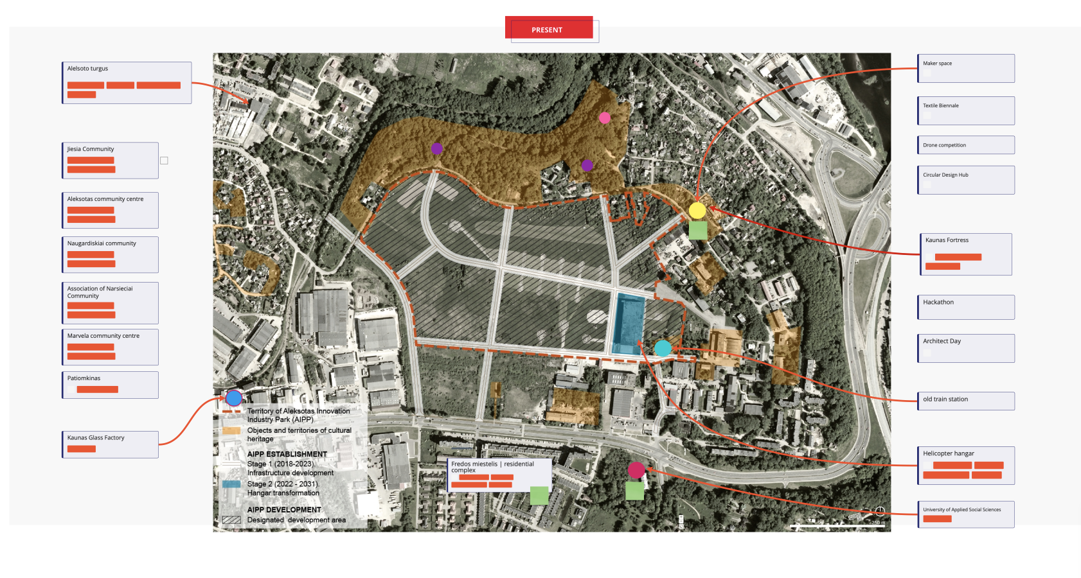
| KAUNAS ALEKSOTAS: Pilot area - AIIP
A

Slide 11
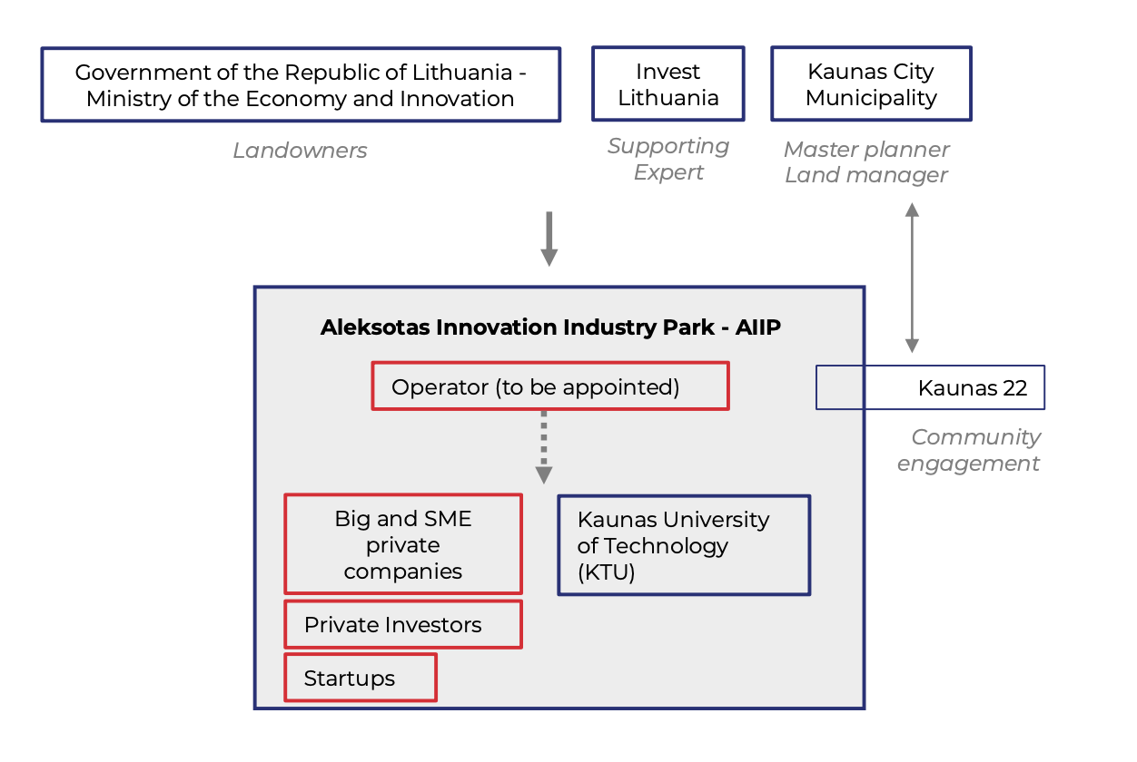
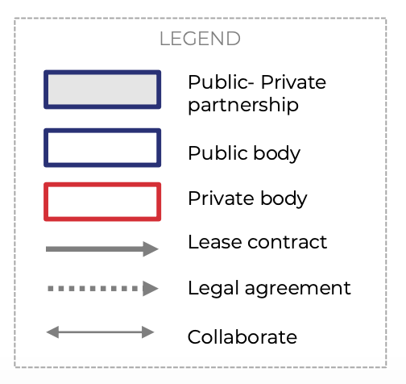
| KAUNAS ALEKSOTAS: People & Stakeholders
Core Team
• Kaunas City Municipality
• Kaunas University of Technology
Local Coalition
• K2022
• Vytautas Magnus University
• Kaunas IN
……
……
……
Regeneration Actors
……
……
……

Slide 12
| KAUNAS ALEKSOTAS: Pilot delivery
2020 june
2021 june
2023 june
WP2
Masterplan
Review
Pilot analysis
overall urban vision
types of urban uses; target-groups
impacts foreseen
type of funding structure & governance
Pilot tech requirements
facility management
technical, legal, regulatory and governance aspects
local funding ecosystem
WP5
Pilot
Delivery
Inquiring & Exploring
mapping meanings, perceptions & values
Ideating
thematic focus & theme clusters, workshops across themes
Prototyping & Testing
Prompt uses
Regular uses
Permanent (‘meanwhile’) uses
WP7
Pilot
Evaluation
Evaluating
Intermediate & Final evaluation reports

Slide 13
| KAUNAS ALEKSOTAS: Challenges and Opportunities
Challenges
Opportunities
1. Identity & Communication
Area is unknown and undiscovered by many.
There is a need to develop and communicate the identity of the AIIP
2. Meanwhile infrastructure
Lack of both ‘operational’ (buildings) and ‘strategic’ (legislation) meanwhile infrastructure on the site
3. Connecting with Local Communities
Little engagement and involvement of local communities & actors so far
4. Open vs closed
The site may be open and abandoned outside work hours and so early adopting businesses may not feel secure or comfortable.
1. Cultural & Heritage assets
Rich and diverse cultural heritage on and around the site.
Some groups are already using the site for leisure activities e.g. roller-skating, walking.
two-stage meanwhiles: 1-cultural and leisure activities (short – medium) and 2- thematic R&D in biotech (medium-long term)
2. Meanwhile experimentation zone
Sand box for R&D
Architects, designers, artists may be interested in experimenting with meanwhile structures
Post-Covid outdoor/Covid friendly venues.
AIIP bordered by buildings and arch. structures that present opportunities for meanwhile use.
3. Working with existing Community, Cultural & Heritage Actors
There are a number of arts/cultural, business and community groups nearby that could be engaged
4. Cultural and leisure amenities
Meanwhile activations can provide ‘activity support’, ‘territoriality’, ‘informal surveillance’ and ’guardianship’
IAT@T as an international reference and activator of partnerships that contribute to turn Trafaria into a lively and attractive area

Slide 14
| KAUNAS ALEKSOTAS: State of the art & milestones
2021 - 2022
AIIP
AIIP Development Plan (Kaunas City) to be prepared until the end of 2021/beginning of 2022
T-Factor
Pilot report delivered
Stakeholder report end of Sept. 2021
Support activities (by T-Agency & T-Labs) end of 2021 /beginning of 2022. Aimed to activate meanwhile and city making by addressing the challenges and opportunities of the pilot territory.
Design-driven city-making Tools (Polimi) end of Jan 2022
Exploring & Inquiring end of November 2021
Ideating (meanwhile activity plan) draft: end of Dec 2021 / final: end of March 2022
Prototyping (starting meanwhile uses): April 2022

Slide 15
| KAUNAS ALEKSOTAS: Support activities
Governance of Innovation ecosystems
-
AIIP Development Plan
Digital Placemaking
Access to Meanwhile Forum/Business models
Use of digital technology in urban regeneration:
local sense-making, community building, storytelling,
inclusion, digital literacy
Support for accessing meanwhile spaces within regeneration sites. Drawing on EXAMPLES and local activities developed within pilots; discussion on barriers and how they are overcome
Future Identity
Co-creation
T-Agency & T-Labs supported Workshops & Consultancy
Co-creation of place-based identities/communications

Slide 16
| KAUNAS ALEKSOTAS: Support activities
Governance of Innovation ecosystems
-
AIIP Development Plan
Access to Meanwhile Forum/Business models
Digital Placemaking
Meanwhile uses
Meanwhile uses
Future Identity
Co-creation
Co-delivered with local LC
Meanwhile uses
Meanwhile uses

Slide 17
t-factor.eu
T-FACTOR HAS RECEIVED FUNDING UNDER HORIZON 2020
RESEARCH & INNOVATION PROGRAMME WITH GRANT AGREEMENT NO. 868887

