Slide 1
Gender balance on Boards direktyva: kur šiandien yra Europa?
Jolanta Reingardė, EIGE

Slide 2
ES Direktyva 2022/2381
on gender balance on company boards
Apimtis
Priemonės turėtų būti taikomos biržinėms bendrovėms (neturėtų būti taikomos MVĮ)
Tikslai ​
kad valdybose nepakankamai atstovaujamos lyties asmenys užimtų ne mažiau kaip 40 % nevykdomųjų direktorių arba 33 % visų direktorių pozicijų iki birželio 2026
Perkėlimas į nacionalinę teisę – gruodžio 28, 2024
Notes:
Šioje direktyvoje numatytos priemonės turėtų būti taikomos biržinėms bendrovėms;
Ši direktyva neturėtų būti taikoma labai mažoms, mažosioms ir vidutinėms įmonėms (toliau – MVĮ);
Transposition deadline
December 2024
EIGE’s data on largest listed companies cover the decision-making positions of the highest ranked nationally registered constituents (max. 50) of the blue-chip index of the national stock exchange in each country.
Publicly listed means that the shares of the company are traded on the stock exchange. This is the key element for EIGE’s sample and not exactly the size of the company in terms of employees. The "largest" companies are taken to be the members (max.50) of the primary blue-chip index, which is an index maintained by the stock exchange and covers the largest companies by market capitalisation and/or market trades. Only companies which are registered in the country concerned (according to the ISIN code) are counted. Therefore, the number of companies covered by the data may be lower than the number of constituents in the relevant blue-chip index (attached, mapping table with list of allocated companies per country and further details available in the related metadata).

Slide 3
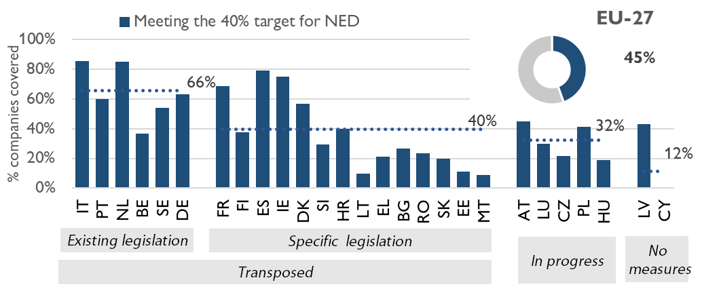
Santykis bendrovių, kurios pasiekė ne mažiau kaip 40 % nevykdomųjų direktorių tikslą (NED), spalis, 2025
Source: EIGE Gender Statistics Database, largest listed companies (unpublished microdata)
Notes:
According to the latest data collected in October 2025 three quarters of Member States (20 of 27) had fulfilled the requirement to transpose the Directive on gender balance on company boards.
Fourteen adopted new legal texts while the other six (Belgium, Germany, Italy, the Netherlands, Portugal, and Sweden) already had equivalent legal provisions.
Transposition is in progress in five further countries (Czechia, Luxembourg, Hungary, Austria, and Poland), but six months after the legal deadline, neither Cyprus nor Latvia had reported any new legal measures.
Notes on the data: EIGE’s data covers largest listed companies (559 companies in the EU Member States, Oct-2025). The current analysis and data presented uses microdata to show findings in the context of the Directive.
EIGE’s data on largest listed companies cover the decision-making positions of the highest ranked nationally registered constituents (max. 50) of the blue-chip index of the national stock exchange in each country.
Publicly listed means that the shares of the company are traded on the stock exchange. This is the key element for EIGE’s sample and not exactly the size of the company in terms of employees. The "largest" companies are taken to be the members (max.50) of the primary blue-chip index, which is an index maintained by the stock exchange and covers the largest companies by market capitalisation and/or market trades. Only companies which are registered in the country concerned (according to the ISIN code) are counted. Therefore, the number of companies covered by the data may be lower than the number of constituents in the relevant blue-chip index (attached, mapping table with list of allocated companies per country and further details available in the related metadata).
Less than half (45 %) of companies had at least 40 % of each gender amongst NED
Differences by Directive transposition status:
66% companies meet target in MS with pre-existing legislation
32% companies meet the target in MS where transposition in progress.
In Lithuania 10% of the covered companies by the data collection (2 out of 20) reached the 40% women among non-executive directors

Slide 4
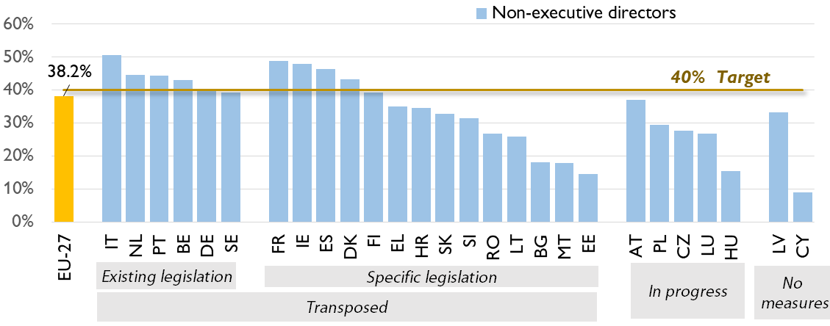
Moterų dalis tarp nevykdomųjų direktorių, spalis, 2025
Source: EIGE Gender Statistics Database, largest listed companies (unpublished microdata)
Notes:
Large corporations in the EU are close to 40 % target for non-executive directors (Oct 2025)
Overall, 38.2 % women amongst NED
40 % target reached in 9 MS
<20 % women NED in 5 MS (BG, MT, EE, HU, CY)
In Lithuania, the share of women among non-executives is 26.0 % (apologies for skipping this in the speaking points).

Slide 5
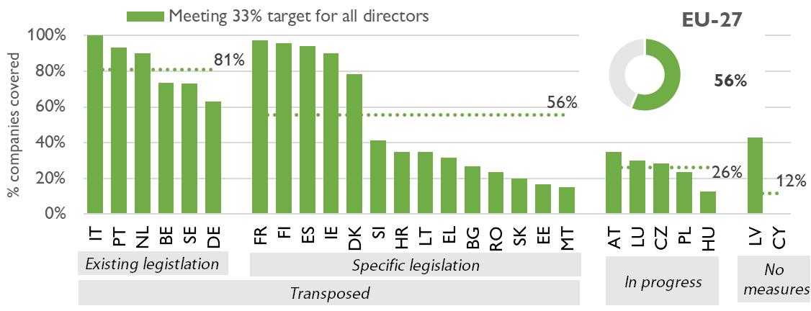
Santykis bendrovių, kurios pasiekė 33 % visų direktorių tikslą, spalis, 2025
Source: EIGE Gender Statistics Database, largest listed companies (unpublished microdata)
Notes:
In the EU more than half (56 %) of companies with ≥33 % of each gender amongst directors
Differences by transposition status:
81% meet the target in MS with pre-existing legislation
26% companies meet target in MS where transposition is in progress.
In Lithuania 35% of the covered companies by the data collection (7 out of 20) reached at least 33 % of women among all directors

Slide 6
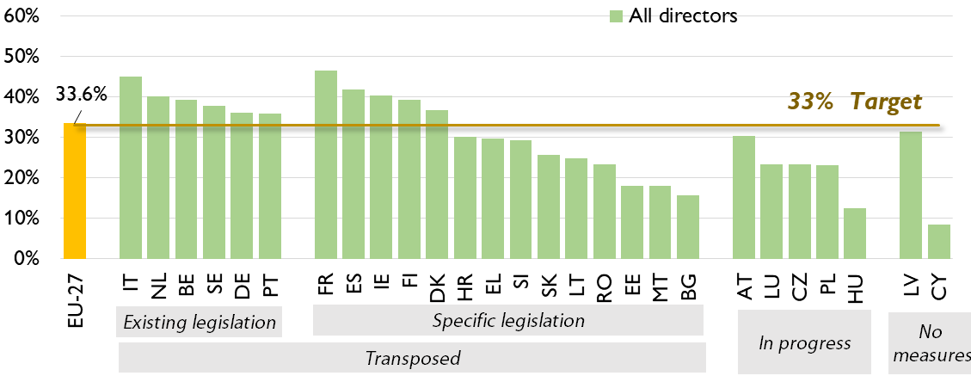
Moterų dalis tarp visų direktorių, spalis, 2025
Source: EIGE Gender Statistics Database, largest listed companies (unpublished microdata)
Notes:
Women’s representation among directors across the EU reaches the 33 % Directive target (Oct 2025)
Overall, 33.6 % women held director seats
At least 33 % women in 11 MS
<15 % women in HU and CY
In Lithuania 24.8 % of women held Director seats

Slide 7
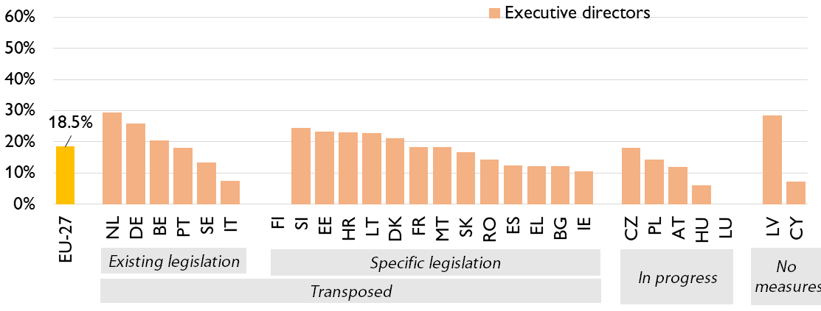
Moterų dalis tarp vykdomųjų direktorių, spalis, 2025
Source: EIGE Gender Statistics Database, largest listed companies (unpublished microdata)
Notes:
Data for executive directors show that women are heavily underrepresented in this position.
In October 2025, less than a fifth (18.5 %) of executive board seats of largest companies across the EU were occupied by women.
This represents an increase of 2.3 pp from 16.2 % in October 2022, just before the Directive was adopted.
more than a quarter of executive directors were women in the largest companies in the Netherlands (29.4 %), Germany (26.0 %), and Latvia (28.6 %)
Less than one in ten in Italy (7.4 %), Hungary (6.1 %), and Cyprus (7.3 %).
Strikingly, none of the companies covered in Luxembourg had any women executive directors.
In Lithuania 22.7 % of executive directors were women in the largest companies

Slide 8
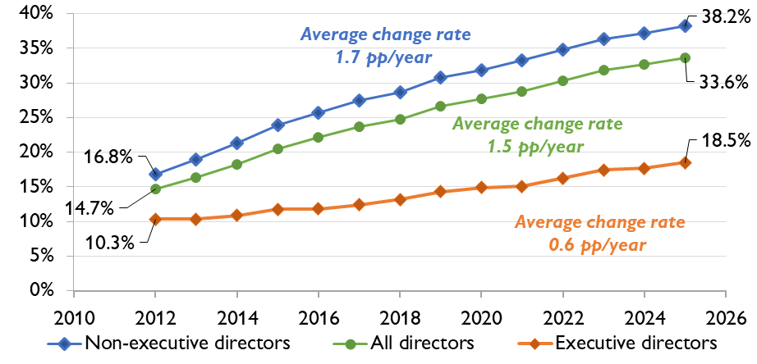
Moterų dalis tarp biržinių bendrovių direktorių pareigas einančių asmenų, spalis 2012 – spalis 2025
Source: EIGE Gender Statistics Database, largest listed companies (unpublished microdata)
Notes:
Progress amongst non-executive directors nearly 3 times faster than for executive directors (2012-2025)
No binding targets for executive directors in Directive (nor in pre-existing legislation in MS)
Since 2012, increase in % women NED nearly 3 times faster than for executive directors (1.7 pp/year vs. 0.6pp/year)

Slide 9
ES Direktyvos įgyvendinimo progresas
7 ES šalys narės dar neperkėlė Direktyvos į nacionalinę teisę.
Reikšminga dalis bendrovių nepasiekė Direktyvos tikslų, ypač šalyse, kurios dar neperkėlė direktyvos į nacionalinę teisę.
Moterų dalis tarp visų direktorių ES - 33.6 %, nevykodmųjų direktorių - 38.2%. Moterys itin menkai atsotvaujamos tarp vykdomųjų direktorių- 18.5 % women. Reikšmingi skirtumai tarp šalių.

